Slide 1
The IPO Blockchain
Anish Malladi | Kevin Yao
PH360 | Prof. Anita Raja

Slide 2
Project Hypothesis
A Blockchain based implementation of the IPO process will:
Eliminate the need for a middleman (underwriter)
Increase transparency
Alleviate cost pressure on businesses.

Slide 3
The IPO Process
Valuation in public domain ^{[1]}
After-market Stabilization
Roadshow!
Pricing
Due Diligence
Selecting Underwriters
Listing happens here!
12-18 months
6-9 months
Years^{[2]}

Slide 4
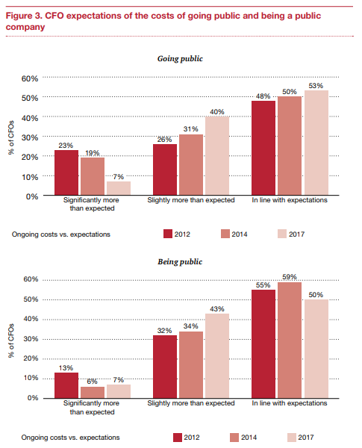
IPO Expenditures
^{[4]}

Slide 5
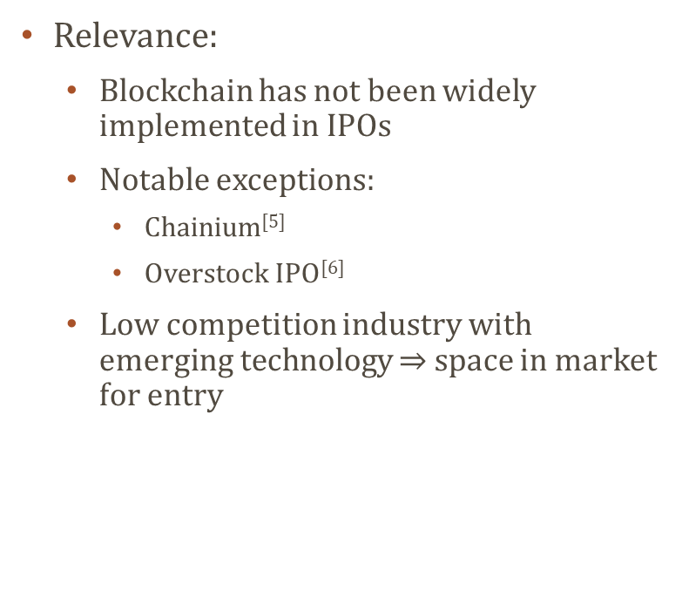
Blockchain Use Case
Relevance:
Blockchain has not been widely implemented in IPOs
Notable exceptions:
Chainium^{[5]}
Overstock IPO^{[6]}
Low competition industry with emerging technology $⇒$ space in market for entry
Use case criteria^{[7]}:
Transparency
Inefficiency
Trust-dependent
Coordination

Slide 6
Platform and Methods
Hyperledger!
Two-step implementation
Process phase – similar to Vehicle Lifecycle Network^{[8]}
Final phase – Auction-type token sale
Process phase
MAS:
Includes company, auditors, underwriters, lawyers, government, public
Easier share allocation, ensures that all due diligence is duly completed
Final Phase
Dutch/Vickrey auction for share allocation^{[9]}
Can include institutional investors

Slide 7
Evaluation and Deliverables
Working code based network
Multiagent lifecycle functionality
Auction network
Usage documentation
Recorded on project page: pages.github.com
Also look into Hyperledger as a hosting platform

Slide 8
Expected Challenges
Blockchain for process phase
Working with Hyperledger framework?
Auction implementation:
Implementation in Hyperledger
Share price revision over time?
Transaction speed on Blockchain?
Auction format flexibility?

Slide 9
Timeline of Events
April 9: Proposal Presentation
April 16:
Initial blockchain blueprint and class structure
April 23:
Simple auction model
April 30: Perform tests on working model with auction focus
May 7: Finish deliverables

Slide 10
References
1: https://corporatefinanceinstitute.com/resources/knowledge/finance/ipo-process/
2: https://www.pwc.com/us/en/services/deals/library/cost-of-an-ipo.html
3: https://www.theipojournal.com/2016/03/2016-ipo-study-ipo-fees-and-expenses/
4: https://www.pwc.com/us/en/deals/publications/assets/cost-of-an-ipo.pdf
5: https://chainium.io/uploads/files/Chainium-Business-Whitepaper-v3.pdf
6: http://www.the-blockchain.com/2016/03/17/overstock-com-announces-historic-blockchain-public-offering/
7: Consensys, “Designing a good Blockchain Use Case”. Moodle, Accessed 09.04.18
8: http://composer-playground.mybluemix.net
9: Demos, Telis. (21 June 2012) What Is a Dutch Auction? – Deal Journal – WSJ. Blogs.wsj.com. Retrieved on 2012-10-16.

